Slide 1
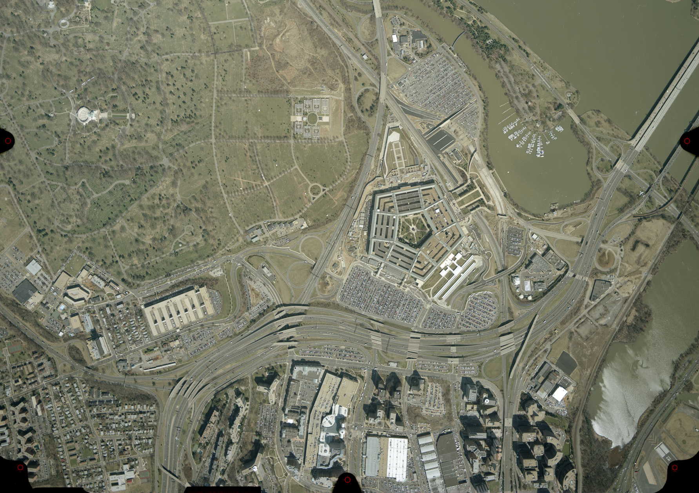

Washington Headquarters Services
Executive Services Directorate
Directives Division
Office of Information Management (OIM)
DoD Information Collection Program
Action Officer (AO) Training
Session One: Internal
Monday, September 19, 2016
0800-1000

Slide 2
Agenda
Efforts and responsibilities of the DoD Internal Information Collections (IIC) Program
Information Collection & RCS 101
The DoD IIC approval process/obtaining a report control symbol (RCS)
Revisions, extensions, collections prescribed in issuances, emergency approval procedures, and external collections
Current OIM Projects and Program Improvements
Announcements / Future Trainings
Please sign in and take a class materials packet.

Slide 3

Contact Information
DoD Directives Organizational Mailbox:
  whs.mc-alex.esd.mbx.dod-directives@mail.mil
  All Document submissions must be sent to this mailbox
Mr. Frederick Licari
  Office of Information Management (OIM) Team Lead
  DoD Internal Information Collections Officer (IICO)
  DoD Clearance Officer
Shelly Finke, Tyler Robinson, Karl Pabst, Caitlyn Borghi, Kaitlin Chiarelli, Mayra Dalence, and Ian Armstrong
  Information Management Analysts
  Information Collections Org. Box: whs.mc-alex.esd.mbx.dd-dod-information-collections@mail.mil (for questions and correspondence)

Slide 4
Efforts and Responsibilities of the DoD IIC Program
Review all DoD issuances for Congressional, public and DoD IICs to ensure that the appropriate procedures are followed
We also review forms and SORNS for potential collection requirements
Manage, control, license, and track all DoD internal information collections
Develop, populate, and maintain a searchable database that houses information and documents relevant to DoD IICs
With DoD IICO, oversee the implementation of DoDM 8910.01 Volume 1

Slide 5
Information Collection 101
An information collection is:
The standardized "collection of information" for a specific purpose, regardless of form or format. The results of an information collection are owned by the requester, are solicited from respondents, and have an associated frequency.
Is more than minimal information
  Name, address, phone number, and email
Notes:
Input instrument- how you collect / solicit the data
Out put instrument – what you do or produce using that data
Most common examples are surveys, focus groups, interviews, reports, forms, systems, databases, websites, etc.
Pg. 10 of 8910.01 volume 1
Is more than minimal information
Name, address, phone number, and email

Slide 6
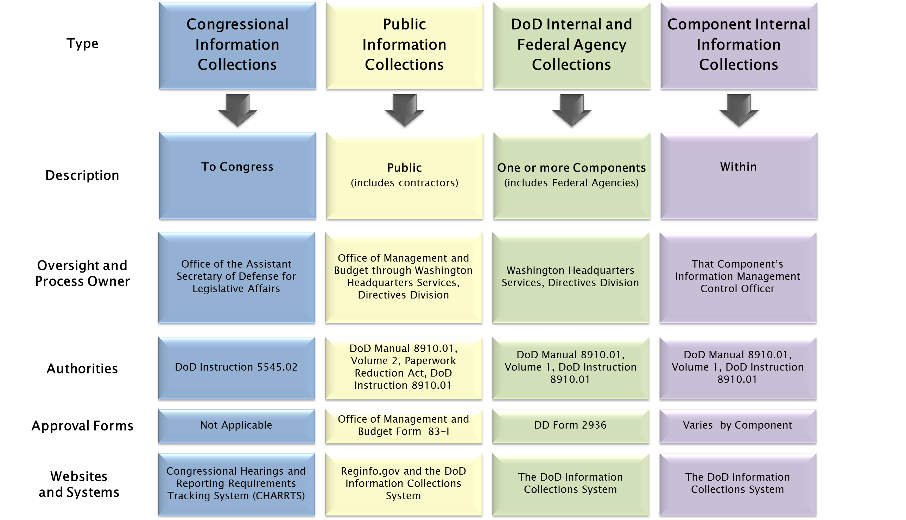
Types of DoD Information Collections
Component
Notes:
Should be familiar for those who went to the DoD issuance training
In this class we’ll focus on the third column only
The fourth column, component internal, depends on your IMCO and component, but can use this (internal) program to model yours after

Slide 7
Who is considered a DoD “Internal” population?
There are two groups that make up a DoD Internal Population:
  Active Duty Service / Military Members
  Government / Federal Employees
Exception: 10 U.S.C. Chapter 88, Sec. 1782 “Surveys of Military Families”
  Must be used to determine the effectiveness of Federal programs relating to military families and the need for new programs.
    Members of the armed forces (active duty, active status, or retired);
    Family members of such members; and
    Survivors of deceased retired members and of members who died while on active duty.
  Responses must be voluntary.
  Collection instrument must be a survey.
    Example: POTFF Survey
Notes:
1782 – covers pops. That would normally be public and makes them internal

Slide 8
Why do I need a license?
To reduce duplication and lower the cost of collections
To ensure compliance with more than 300 laws, regulations, and issuances concerning:
  Privacy and personally identifiable information
  Records management and disposition
  Information assurance
  Security
  Human research protection
  Survey construction best practices
Notes:
Question: How much do you think the most expensive Internal Information Collection costs to conduct each year?
Answer : Over $18 MILLION dollars.
It’s a big outlier – the second most expensive internal IC is only around $5 million a year.
Lesson: reducing burden and overall cost to the department is a top priority for us. We will never question why you are conducting a collection, but we will ask certain questions to try and see if we can reduce the frequency or overall cost of burden for a collection.

Slide 9
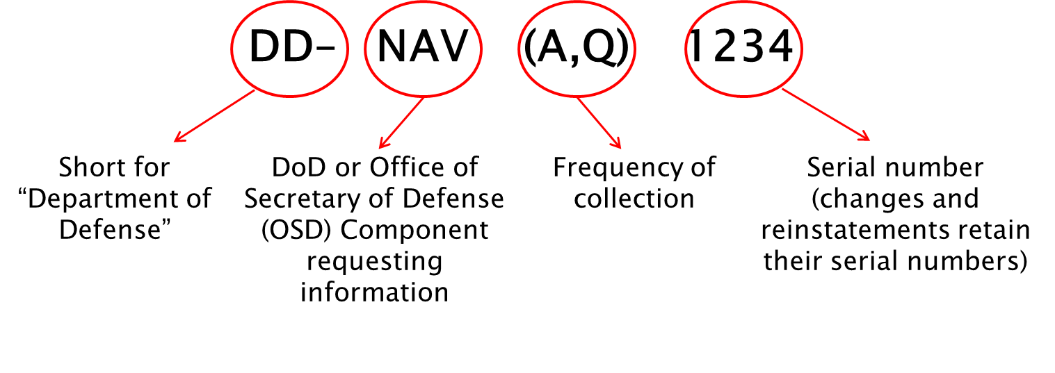
A Report Control Symbol (RCS) Explained
Notes:
Unique identifier for each approved DoD internal information collection; serves as a symbol of authenticity and approval
Looking at the RCS can tell you the Component it belongs to (can only be 1)
Frequency of collection (can be more than 1)
Numbers on the end tell you that it has been approved
Unapproved collections will have letter placeholders instead of numbers
Should be displayed on the instrument and supporting materials, such as instructions

Slide 10
What Doesn’t Need a License?
17 potential “exemptions”:
  Common examples include financial audits, substantive intelligence reporting, investigations of charges, and personnel records
  Exemptions for internal collections do not constitute exemptions from Congressional or public collection requirements (and vice versa)
  Exemptions for internal collections do not exempt the collection from the data protection laws, regulations, and policies (e.g., privacy, records, information assurance)
  You can find more information on this in Enclosure 3 of Volume 1 of DoD Manual 8910.01, but remember that ultimately the DoD IICO makes the final call / determination.
Notes:
You can find more information on this in Enclosure 3 of Volume 1 of DoD Manual 8910.01, but reminder that ultimately, it is up to the DoD IICO to make that final call.
If we can fit it under an exemption, we will ! Burden reduction at it’s finest.
There are more than public – not all the same
We help determine and fred has final call

Slide 11

Copies of Collections
Is a copy if:
  The requirement to collect the data is previously established / the requirement is already licensed
  No change in the instruments’ formats
  No supplemental data
  No additional frequency
Is not a copy if:
  If establishing the requirement for a Component to collect the data and then requesting to obtain that data
Contact OIM with questions

Slide 12
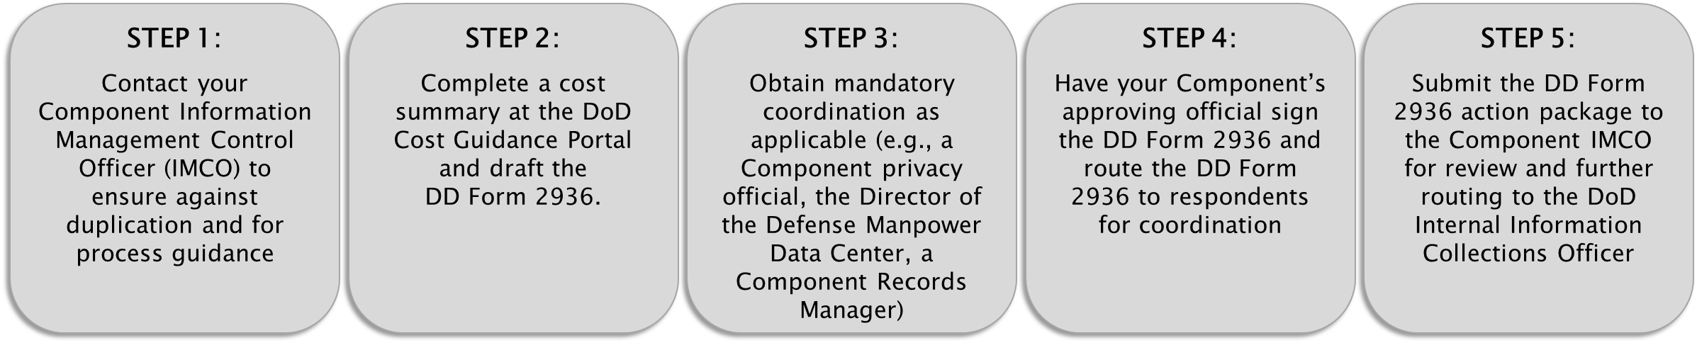
Overview of the RCS Assignment Process
Notes:
Typical / Average Timeline for approval is 2.5 – 3 months

Slide 13
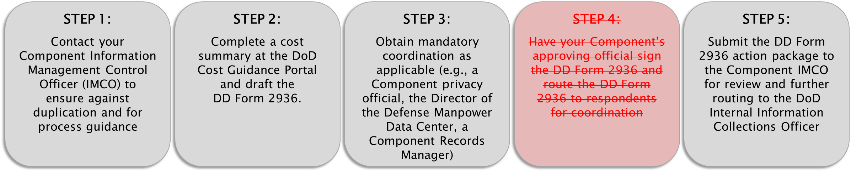
Overview of the RCS Assignment Process with a DoD issuance
Notes:
Unable to provide an estimated timeline for internal IC approval because they are tied to issuances and each issuance (depending on type, length, subject matter) take a unique amount of time to publish.

Slide 14
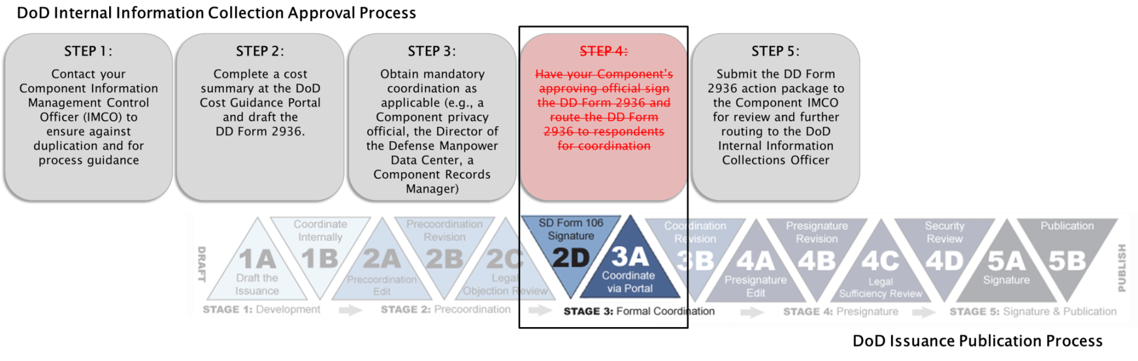
Overview of the RCS assignment process with its DoD issuance
DoD Internal Information Collections Approval Process
Notes:
- The reason for the elimination of step 4 in the approval process is because it is accomplished through formal coordination of the issuance.

Slide 15
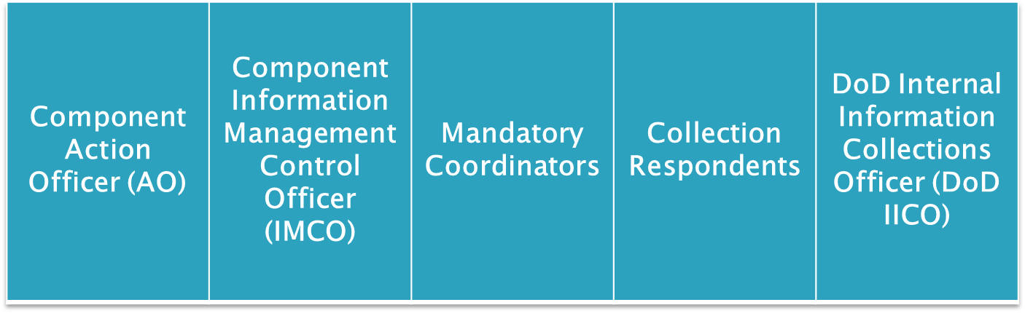
Process Participants
Notes:
Key players in the approval process to obtain a report control symbol for your DoD internal information collection.
Component AO works the package in collaboration with the IMCO
If you don’t know who your Component IMCO is, we have a POC List available (and maintained) on our website
We’ll go over the mandatory coordinators in a few slides
The respondents are those participating in the collection, so if it’s a survey, for example, they are those who are responding to the survey
The DoD IICO is Mr. Licari and our staff serve as his support.

Slide 16
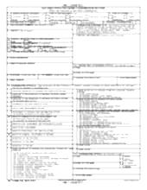
Component Action Officer (AO) | Component Information Management Control Officer (IMCO) | Mandatory Coordinators | Collection Respondents | DoD Internal Information Collections Officer (DoD IICO)
Contacts IMCO | Ensures against duplication and advises
Component Action Officer (AO) | Component Information Management Control Officer (IMCO) | Mandatory Coordinators | Collection Respondents | DoD Internal Information Collections Officer (DoD IICO)
Contacts IMCO | Ensures against duplication and advises
Completes cost summary and drafts DD Form 2936
Step 2
The requesting Component’s AO completes a cost summary at the DoD Cost Guidance Portal and drafts the DD Form 2936
Step 1
Step 1
The action officer conceptualizes the collection and makes contact with his or her Component Information Management Control Officer (IMCO)
The Component IMCO confirms the collection requires a report control symbol (RCS), advises on the approval process, and ensures the collection is not duplicative
Step 2
Component Action Officer (AO) | Component Information Management Control Officer (IMCO) | Mandatory Coordinators | Collection Respondents | DoD Internal Information Collections Officer (DoD IICO)

Slide 17
Step 2: Complete Cost Summary Estimate(CAPE) and draft DD Form 2936
After contacting your Component IMCO, next step is to complete a cost summary on the CAPE website:
  https://www.cape.osd.mil/CostGuidance/
  Must have common access card (CAC) to complete cost summary
  Select “Information Collections” (do not select “Studies and Reports”)
Costs are calculated for one full fiscal year.
The requester of the information collection completes cost summary for all costs.
Cost summaries must be completed before routing the DD Form 2936 package to your SES (or higher depending on cost threshold) for signature and before routing to the responding Components for coordination.
  Cost estimate (CAPE Report) will generate next step, DD Form 2936
Notes:
Costs are calculated for one full fiscal year.

Slide 18
Step 2: Complete cost summary (CAPE) and draft DD Form 2936
In order to complete the CAPE, you must know:
  How many respondents will you have?
  How long will it take a respondent to respond to the collection?
  How often will the information be collected? (frequency)
  What is the average GS level (or equivalent) of your respondents?
  What are the recurring & non-recurring labor and non-labor costs to your organization/Component for owning or sponsoring this collection?
  Be able to provide collection-cost summary methodology statement

Slide 19
Step 2: Complete cost summary (CAPE) and draft DD Form 2936
Information required to complete a cost summary:
  How many respondents will you have and how long will it take the respondents to respond to the collection request?
  How often will the information be collected?
  What is the average GS level (or equivalent) of your respondents?
  What are the recurring and non-recurring / labor and non-labor costs to your organization/Component for owning or sponsoring the collection?
  5 Components 10 personnel each; 30 minutes per person to respond
  Annually and monthly (13 times during fiscal year 2016)
  Army, Navy, Air Force: O-4 and USD(P&R), USD(AT&L): GS-12
  $1000 one time contract cost; 1 hour of GS-14 time and $100 in postage each time the survey is administered
Notes:
Important for you to be able to answer these questions about your collection. This is not information that we could give you, as you are the SME.
If you’re unsure as to the grade level of your respondents, take an average. Some collections target a very specific grade level, such as individuals in leadership positions, so GS-14/15s/SES. But if you don’t know, or you’re taking a range, use an average
If you’re unsure as to how many times the collection will take place during the year, then use the frequency “As Required.”

Slide 20
Step 2: Example cost summary methodology statement
  This survey will be administered to Army, Navy, Air Force, the OUSD(P&R), and the OUSD(AT&L) monthly and annually. We will survey 10 individuals in each responding DoD/OSD Component and it will take each individual approximately 30 minutes to complete the survey. The cost to the requesting Component to develop this survey is an initial contract cost of $1000. Each time the survey is administered, the requesting Component incurs a $100 cost for postage and 1 hour of GS-14 level labor.
Notes:
- Every cost summary must include a methodology statement, which is essentially a narrative that helps us understand how it is that you calculated your cost/chose the figures that you did. Any special information that you feel it might be pertinent for us to know, such as, cost is being calculated based off an expectation that we’ll receive only 25% responses from what is sent out, that’s something you’d want to state here.
*** NOTE: (Reference CAPE handout) – CAPE will calculate exact totals an input them into the DD Form 2936, but will only show rounded totals on CAPE. This is okay!

Slide 21
Completing DD Form 2936
CLASSIFICATION OF INFORMATION COLLECTION: As stated.
DATE OF REQUEST: Enter the date the DD Form 2936 is drafted.
TYPE OF REQUEST: Select the type of collection approval you are seeking (differences between these choices will be explained later)
PRESCRIBING DOCUMENTS: As stated. The justification statement (see section 6 below) may serve as the prescribing document.
INFORMATION COLLECTION DATA: Sections 5a, 5c, and 5f are populated by the DoD Cost Guidance Website. Complete all other sections of the DD Form 2936 as stated.

Slide 22
Completing DD Form 2936
JUSTIFICATION STATEMENT: A justification statement must include:
  A detailed description of how the information will be used, by whom and the purpose. Does the information collection involve the use of technological collection techniques?
  A description of efforts made to reduce the burden and cost on the respondents and a list of risks or penalties associated with not having the information collection request approved.
  If the information collection is a survey, attach the package sent to the Defense Manpower and Data Center (DMDC) to include the DMDC “supporting statement.”
  If the internal information collection is also a collection of information from the public, attach the justification statement submitted with the Office of Management and Budget (OMB) Form 83-I.
REQUESTING COMPONENT ORGANIZATION NAME AND DIRECTORATE: Partly populated by the DoD Cost Guidance Website. Add your directorate.
ACTION OFFICER CONTACT INFORMATION: Contact information for the action officer completing the DD Form 2936. You may list a Defense contractor with a valid DoD email address.

Slide 23
Completing DD Form 2936
REQUESTING COMPONENT OFFICIAL: Have the DD Form 2936 signed by your Senior Executive Service member (not necessary if coordinating via the DoD issuance process and is dependent on cost threshold).
ESTIMATED COST OF INFORMATION COLLECTION: Populated by the DoD Cost Guidance Website.
COORDINATION: Select the applicable mandatory coordination. Signature and date signed are to be completed by the mandatory coordinators.
RESPONDENT(S) COORDINATION: This section and the second page of the DD Form 2936 is populated by the DoD Cost Guidance Website.
DoD COMPONENT INFORMATION MANAGEMENT CONTROL OFFICER (IMCO): To be completed by the Component Information Management Control Officer.
FOR USE BY DoD INTERNAL INFORMATION COLLECTIONS OFFICER ONLY:
As stated.
Notes:
12.b. must be signed by an SES at a minimum
If the collection will cost the responding components more than $500,000, 12.b. must be signed by the DoD or OSD Component Head.

Slide 24

Cost-Dependent Signature Levels
If the cost of the collection to the Requesting Component (10.c. of DD Form 2936) is less than $500,000 annually, Block 9 must be signed, at the minimum, at the SES level
If the cost of the collection to the Requesting Component (10.c. of DD Form 2936) is more than $500,000 annually, Block 9 must be signed, at the DoD or OSD Component Head level (or equivalent)
Likewise, in Step 4 (Respondent Coordination), if the cost of the collection to a responding component (found on Block 12 of DD Form 2936) is less than $500,000 Blocks 12.a.-e. must be signed, at the minimum, at the SES level
If the cost of the collection to a responding component (found on Block 12 of DD Form 2936) must be signed at the DoD or OSD Component Head level (or equivalent)

Slide 25
- BREAK -
UP NEXT:
The DoD Internal Information Collections (IIC) Approval Process Steps 3 & 4:
Obtaining Mandatory and Respondent Coordinations

Slide 26
Component Action Officer (AO) | Component Information Management Control Officer (IMCO) | Mandatory Coordinators | Collection Respondents | DoD Internal Information Collections Officer (DoD IICO)
Contacts IMCO | Ensures against duplication and advises
Completes cost summary and drafts DD Form 2936
Component Action Officer (AO) | Component Information Management Control Officer (IMCO) | Mandatory Coordinators | Collection Respondents | DoD Internal Information Collections Officer (DoD IICO)
Contacts IMCO | Ensures against duplication and advises
Completes cost summary and drafts DD Form 2936
Submits to mandatory coordinators; adjudicates comments |  | Review and provide coordination
Step 1
Step 3
The AO submits the collection instrument, supporting documentation, and the DD Form 2936 to mandatory coordinators
Mandatory coordinators review collection instrument and provide coordination
The AO adjudicates comments from mandatory coordinators
Step 2
Step 3
Instrument
2936

Slide 27
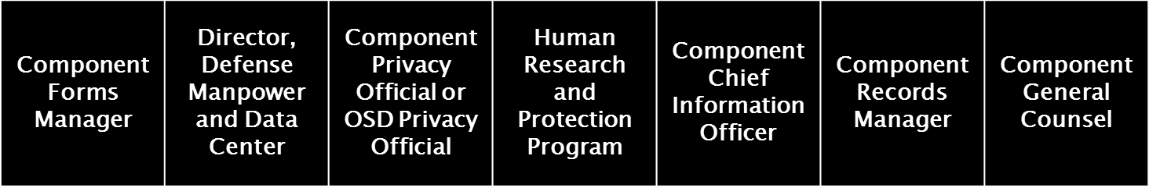
Who are the Mandatory Coordinators?

Slide 28
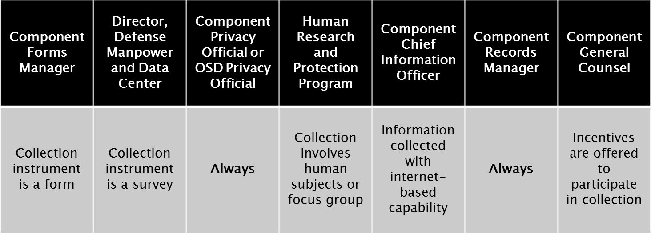
When is each Mandatory Coordinator needed?
Notes:
Determine which Mandatory Coordinators’ approval is necessary for collection and AO submits 2936 to all concurrently
Can either sign copy of 2936 or provide an approval memo

Slide 29


Mandatory coordinators’ coordination processes
Defense Manpower and Data Center (DMDC)
Coordination Process
1. AO drafts a DMDC supporting statement
2. AO submits collection instrument, DD Form 2936, and supporting statement via email to DMDC
3. DMDC conducts review and assists AO directly
Component Forms Manager
Coordination Process
Assists AO throughout the report control symbol process with the DD Form 67 approval process
Component Forms Manager | Director, Defense Manpower and Data Center | Component Privacy Official or OSD Privacy Official | Human Research and Protection Program | Component Chief Information Officer | Component Records Manager | Component General Counsel
DD Form 67 process
Component Forms Manager | Director, Defense Manpower and Data Center | Component Privacy Official or OSD Privacy Official | Human Research and Protection Program | Component Chief Information Officer | Component Records Manager | Component General Counsel
DD Form 67 process | DRS, email, pass on to OSD privacy official and HRPP official
Notes:
Take out, probably (or don’t include with slide packet)

Slide 30





Mandatory coordinators’ coordination processes
Component or OSD Privacy Official
Coordination Process
1. AO submits collection instrument and DD Form 2936 via Email
or
1. DMDC submits DD Form 2936, collection instrument and supporting statement to the OSD privacy official
2. Privacy official provides review and assists AO directly
Human Research Protection Program
Coordination Process
1. DMDC submits DD Form 2936, collection instrument and supporting statement to the office of the Human Research and Protection Program (HRPP)
2. HRPP official provides review and assists AO directly
Component Chief Information Officer
Coordination Process
1. AO submits collection instrument and DD Form 2936 via Email
2. Component Chief Information Officer provides review and assists AO directly
Component General Counsel
Coordination Process
1. AO submits collection instrument and DD Form 2936 via email
2. Component General Counsel provides review and assists AO directly
Component Forms Manager | Director, Defense Manpower and Data Center | Component Privacy Official or OSD Privacy Official | Human Research and Protection Program | Component Chief Information Officer | Component Records Manager | Component General Counsel
DD Form 67 process | DRS, email, pass on to OSD privacy official and HRPP official | Email
Component Forms Manager | Director, Defense Manpower and Data Center | Component Privacy Official or OSD Privacy Official | Human Research and Protection Program | Component Chief Information Officer | Component Records Manager | Component General Counsel
DD Form 67 process | DRS, email, pass on to OSD privacy official and HRPP official | Email | Email | Email | Email
Component Forms Manager | Director, Defense Manpower and Data Center | Component Privacy Official or OSD Privacy Official | Human Research and Protection Program | Component Chief Information Officer | Component Records Manager | Component General Counsel
DD Form 67 process | Email | Email | Email | Email | Email | Email
Component Forms Manager | Director, Defense Manpower and Data Center | Component Privacy Official or OSD Privacy Official | Human Research and Protection Program | Component Chief Information Officer | Component Records Manager | Component General Counsel
DD Form 67 process | DRS, email, pass on to OSD privacy official and HRPP official | Email | Email
Component Forms Manager | Director, Defense Manpower and Data Center | Component Privacy Official or OSD Privacy Official | Human Research and Protection Program | Component Chief Information Officer | Component Records Manager | Component General Counsel
DD Form 67 process | DRS, email, pass on to OSD privacy official and HRPP official | Email | Email | Email
Component Records Manager
Coordination Process
1. AO submits collection instrument and DD Form 2936 via email
2. Component Records Manager provides review and assists AO directly

Slide 31
Component Action Officer (AO) | Component Information Management Control Officer (IMCO) | Mandatory Coordinators | Collection Respondents | DoD Internal Information Collections Officer (DoD IICO)
Contacts IMCO | Ensures against duplication and advises
Completes cost summary and drafts DD Form 2936
Component Action Officer (AO) | Component Information Management Control Officer (IMCO) | Mandatory Coordinators | Collection Respondents | DoD Internal Information Collections Officer (DoD IICO)
Contacts IMCO | Ensures against duplication and advises
Completes cost summary and drafts DD Form 2936
Submits to mandatory coordinators; adjudicates comments |  | Review and provide coordination
Step 1
Step 2
Step 3
Instrument
2936
Notes:
Also don’t include in slide packet

Slide 32
Step 4
The AO submits the DD Form 2936 action to their SES for signature in section 9 (or Component Head if
collection is worth more than $500,000 ) and then to respondents for coordination on the cost and spirit of the collection
Each responding Component provides coordination and SES signature on the DD Form 2936
The AO adjudicates comments received from respondents
OR
If the information collection is routed for approval via the DoD issuance process, do not obtain requesting Component signature in section 9 or respondents signatures (in section 12)
on the DD Form 2936
However, cost information must be listed in section 8, “Information Collection Requirements” of the SD Form 106, “DoD Directives Program Coordination Record”
Component Action Officer (AO) | Component Information Management Control Officer (IMCO) | Mandatory Coordinators | Collection Respondents | DoD Internal Information Collections Officer (DoD IICO)
Contacts IMCO | Ensures against duplication and advises
Completes cost summary and drafts DD Form 2936
Submits to mandatory coordinators; adjudicates comments |  | Review and provide coordination
Submits to their SES and respondents; adjudicates comments |  |  | Provides coordination and SES signature
Component Action Officer (AO) | Component Information Management Control Officer (IMCO) | Mandatory Coordinators | Collection Respondents | DoD Internal Information Collections Officer (DoD IICO)
Contacts IMCO | Ensures against duplication and advises
Completes cost summary and drafts DD Form 2936
Submits to mandatory coordinators; adjudicates comments |  | Review and provide coordination
Submits to their SES and respondents; adjudicates comments |  |  | Provides coordination and SES signature(s)
Step 1
Step 2
Step 3
Or if coordinated with a prescribing DoD issuance:
Step 4
Step 4
2936
Notes:
Don’t include with slide packet

Slide 33
Prescribing Documents / Authorities
A DoD issuance, DMDC Supporting Statement / Justification Statement, and Interagency Memorandum are not “high” enough to compel participation in a collection
  If a responding component non-concurs during respondent coordination in this situation, this can be mediated between respondent and requester. However, if no solution is reached, the non-concurring responding component can withdraw from participating in the collection.
Statutes, laws, Executive Orders, and Sec. Def. Memorandum are “high” enough to compel participation in a collection.
  If responding components non-concur in this situation, they are still required to participate in the collection
  While issues (including cost) should still be mediated, responding components must still receive 15 working days to submit their response

Slide 34
Processing an Internal Information Collection with an Issuance
Internal Information Collections found in / being processed through an issuance are not required to go through respondent coordination
You must still submit a complete internal action package
  The issuance will serve as your prescribing document in block 4.a. of the DD Form 2936 (if there is a higher authority, also include it in blocks 4.b., 4.c., or 4.d. as appropriate)
  If we do not receive your CAPE Cost estimate by Formal Coordination, this will prevent your issuance from going to the next stage of review
  We must have your complete internal information collection package by the Pre-Signature Review stage of the issuance process
  Issues with respondent coordination and non-concurs are worked out during formal coordination and through the SD 818.
  *** Issuances with incomplete internal information collections requirements will prevent the issuance from publishing***
Notes:
We will leave notes during the pre-coordination review of the issuance, on the SD 106, to denote which blocks you should check off and the language you should include in the Purpose section.
Important to include the cost for the internal collections BEFORE the SD 106 is signed by the approving authority.

Slide 35
Internal Information Collections in DoD Issuances
Example Information Collections Section on the DD Form 106, “DoD Directives Program Coordination Record”
X
X Internal collections
Cost from section 10c of the DD Form 2936
Cost from section 10d of the DD Form 2936
“This issuance prescribes a DoD internal information collection and its cost to the Department is listed in section 8 of this form. The coordination of this issuance will serve as the coordination of this collection and its cost.”
Notes:
We will leave notes during the pre-coordination review of the issuance, on the DD 106, to denote which blocks you should check off and the language you should include in the Purpose section.
Important to include the cost for the internal collections BEFORE the DD 106 is signed by the approving authority.

Slide 36
Internal Information Collections in DoD Issuances
Example Information Collections Requirements Paragraph in DoD Issuance:
INFORMATION COLLECTIONS. The [insert collection title], referred to [paragraph reference] of this instruction, has been assigned report control symbol DD-AT&L(AR)XXXX in accordance with the procedures in Volume 1 of DoD Manual 8910.01. The expiration date of this information collection is listed in the DoD Information Collections System at https://apps.osd.mil/sites/DoDIIC/Pages/default.aspx.
Notes:
- This is the language we’ll add to your issuance, typically during pre-coord review, if we find that you have an internal collection. Some of you have that language already, but for those of you who don’t or aren’t aware that you have a collection in the first place, we’ll put it in for you, as well as mark where in the issuance we found the collection and adding citation to our policy document, DODM 8910.01 Volume 1
Red RCS will change depending on Component, frequency will be inserted if can be deduced from issuance, otherwise it will be an X, and the last four placeholder will start out as XXXX but will be given a specific 4-letter placeholder until the RCS number is assigned.

Slide 37
Internal Information Collections in DoD Issuances
Example Information Collections Requirements Bullet in an Action Memorandum
This issuance prescribes the quarterly training class survey, a DoD internal information collection. The information collection requirement, report control symbol DD-DA&M(Q)XXXX prescribed in this instruction will cost the DoD approximately $7,690.00 annually in fiscal year 2013, Cost Assessment and Program Evaluation identification number 1-09A157F. [Give a brief justification for the information collection requirement. Identify and cite the external or internal source for the requirement.]
Notes:
- This is the language we’ll put in the Action Memorandum for you, prior to it being signed by your approving official. It is up to you as the AO to provide the language in red at the end to briefly justify the requirement.

Slide 38
Knowledge Check Activity
Notes:
Taking a break – give them time to complete activity and then review

Slide 39
Component Action Officer (AO) | Component Information Management Control Officer (IMCO) | Mandatory Coordinators | Collection Respondents | DoD Internal Information Collections Officer (DoD IICO)
Contacts IMCO | Ensures against duplication and advises
Completes cost summary and drafts DD Form 2936
Submits to mandatory coordinators; adjudicates comments |  | Review and provide coordination
Submits to their SES and to respondents; adjudicates comments |  |  | Provides coordination and SES signature
Submits action package to IMCO | Reviews and submits to DoD IICO
Component Action Officer (AO) | Component Information Management Control Officer (IMCO) | Mandatory Coordinators | Collection Respondents | DoD Internal Information Collections Officer (DoD IICO)
Contacts IMCO | Ensures against duplication and advises
Completes cost summary and drafts DD Form 2936
Submits to mandatory coordinators; adjudicates comments |  | Review and provide coordination
Submits to their SES and to respondents; adjudicates comments |  |  | Provides coordination and SES signature
Component Action Officer (AO) | Component Information Management Control Officer (IMCO) | Mandatory Coordinators | Collection Respondents | DoD Internal Information Collections Officer (DoD IICO)
Contacts IMCO | Ensures against duplication and advises
Completes cost summary and drafts DD Form 2936
Submits to mandatory coordinators; adjudicates comments |  | Review and provide coordination
Submits to their SES and to respondents; adjudicates comments |  |  | Provides coordination and SES signature
Submits action package to IMCO | Reviews and submits to DoD IICO |  |  | Reviews, approves and assigns RCS
Component Action Officer (AO) | Component Information Management Control Officer (IMCO) | Mandatory Coordinators | Collection Respondents | DoD Internal Information Collections Officer (DoD IICO)
Contacts IMCO | Ensures against duplication and advises
Completes cost summary and drafts DD Form 2936
Submits to mandatory coordinators; adjudicates comments |  | Review and provide coordination
Submits to their SES and to respondents; adjudicates comments |  |  | Provides coordination and SES signature
 | Reviews and submits to DoD IICO |  |  | Reviews, approves and assigns RCS
Component Action Officer (AO) | Component Information Management Control Officer (IMCO) | Mandatory Coordinators | Collection Respondents | DoD Internal Information Collections Officer (DoD IICO)
Contacts IMCO | Ensures against duplication and advises
Completes cost summary and drafts DD Form 2936
Submits to mandatory coordinators; adjudicates comments |  | Review and provide coordination
Submits to their SES and to respondents; adjudicates comments |  |  | Provides coordination and SES signature
Submits action package to IMCO | Reviews and submits to DoD IICO |  |  | Reviews, approves and assigns RCS
Component Action Officer (AO) | Component Information Management Control Officer (IMCO) | Mandatory Coordinators | Collection Respondents | DoD Internal Information Collections Officer (DoD IICO)
Contacts IMCO | Ensures against duplication and advises
Completes cost summary and drafts DD Form 2936
Submits to mandatory coordinators; adjudicates comments |  | Review and provide coordination
Submits to their SES and to respondents; adjudicates comments |  |  | Provides coordination and SES signature
Submits action package to IMCO |  |  |  | Reviews, approves and assigns RCS
Component Action Officer (AO) | Component Information Management Control Officer (IMCO) | Mandatory Coordinators | Collection Respondents | DoD Internal Information Collections Officer (DoD IICO)
Contacts IMCO | Ensures against duplication and advises
Completes cost summary and drafts DD Form 2936
Submits to mandatory coordinators; adjudicates comments |  | Review and provide coordination
Submits to their SES and to respondents; adjudicates comments |  |  | Provides coordination and SES signature
Submits action package to IMCO | Reviews and submits to DoD IICO
Step 1
Step 5
AO submits DD Form 2936 action package to Component IMCO
Component IMCO reviews action package, signs DD Form 2936 and submits to the DoD IICO
DoD IICO reviews DD Form 2936 action package (cost and coordination), approves information collection and assigns an RCS
Step 2
Step 3
Step 4
Final 2936
DD Form 2936 Action Package
DD Form 2936 Action Package
DD Form 2936 Action Package
Instrument
and Supporting
Statement
Step 5
Cost
Summary
Copies of All Coordination
Notes:
Do not include in slides packet
Our suspense for a review is 5 days (prescribed in 8910.01 Vol. 1) If there are issues, we will send the package back to the IMCO and provide a detailed explanation of what is preventing the package from being approved. Once changes have been made, you should send the revised package to your IMCO to review again, and then they will submit to us.

Slide 40
Approvals Periods and Types of Submissions & Changes

Slide 41
Approval Periods
  New / Reinstatements: 5 years
  One-time collections: 1 year
  Collections with emergency approval: 180 days
  Extensions: No more than 2 years (granted once per reinstatement)
  Collections approved in conjunction with a public collection: 3 years (matches the expiration date of OMB Control Number)
  Revisions: do not alter the expiration date

Slide 42
Reinstatements
Reinstatements are valid for 5 years
Done when an RCS is close to expiring and the collection needs to continue
Done when an RCS has expired and the Component wants to ‘restart’ it
  We must receive a copy of past results of the previously / currently approved collection before reinstating it
In order to obtain a reinstatement, you must submit a new / full internal information collection package (Steps 1-5).
Notes:
Start reinstatement process at least 3 months before collection is due to expire

Slide 43
Revisions (Changes)
A revision is a change to an internal collection that has an active report control symbol
  Minor revisions do not require approval forms, cost summaries, or coordination.
  Major revisions may require coordination of the DD Form 2936, an updated cost summary, and updated mandatory coordination of the collection instrument.
Revisions which increase the cost of the collection by more than $10,000 must go through the full approval process
Contact your Component IMCO or OIM directly for the steps of the DoD internal information collections approval process required for your requested revision.
Notes:
Minor examples – name changes (contact or component), spelling errors, etc.
Major examples – you want to collect from a new component, the cost of your collection is going up, you have a new instrument or major changes to your instrument
****revisions do not change your expiration date.

Slide 44
Extension
An extension may be requested when:
    There is no change in the cost of the collection
    The report control symbol is still active
Extensions are granted only once per reinstatement and for a maximum of two years. Complete steps 1 and 2 of the approval process.
  The coordination normally required in sections 11 and 12a-12e of the DD Form 2936 is not required for extension requests. All other sections of the DD Form 2936 must be completed.
Select “Explanation of Request for Extension” in section 6 (Justification Statement) of the DD Form 2936. Explain why an extension to the information collection is necessary instead of composing a new justification statement and include the explanation as part of the DD Form 2936 action package.

Slide 45

Emergency Approvals
Insufficient planning or administrative oversight does not warrant emergency approval.
The required steps of the approval process for emergency approval requests are determined on a case by case basis.
Emergency approvals receive report control symbols with an expiration date of 180 days.
Submission of all remaining documentation (which was not required at the time emergency approval was granted) is required before the 180 day expiration date of the report control symbol.
Section 9 of the DD Form 2936 must be signed by the OSD or DoD Component Head of the requesting Component for all emergency approval requests.
Contact your Component IMCO or the DoD Internal Information Collections Officer directly to request emergency approval.
Notes:
Recent examples of “true” emergency collections include : survey to service members who were in countries stricken by ebola and the OPM breach

Slide 46
Interagency and External Collections
If another Federal agency (example: Department of State) or entity external to DoD requests information from the DoD (example: RAND), your OSD or DoD Component may serve as the official DoD sponsor for the collection
  Your OSD or DoD Component will complete the DD Form 2936 approval process on behalf of the Federal agency or entity external to DoD.
If your OSD or DoD Component requests information from another Federal agency: Complete the DD Form 2936 approval process as well as any additional procedures required by the other Federal agency.
If you are to requesting information from an entity outside the Federal government, see the DoD Public Information Collections Website for the process to obtain an Office of Management and Budget (OMB) control number.

Slide 47
Collections that are both Public and DoD Internal
Contact your Component IMCO and begin the process to obtain an OMB control number for the public part of the collection as outlined on the DoD Public Information Collections Website.
Complete the cost estimate and DD Form 2936 from step 2of the approval process.
  The cost information prepared for the OMB 83-I Form DOES NOT include the cost to the DoD and OSD Components to respond to the internal information collection. You must complete a separate cost estimate at the DoD Cost Guidance Website in accordance with step 2.
Have the requesting Component’s approving official sign section 9 of the DD Form 2936 and coordinate the collection with the responding Components per step 4.
Section 11 of the DD Form 2936 and step 3 of the approval process are not applicable if routing the collection instrument through the OMB process for approval.
Complete step 5 of the approval process and submit the DD Form 2936 action package to your Component IMCO. A report control symbol will be activated upon activation of the associated OMB control number.
Notes:
Gets the same expiration date as the public collection (3 years)

Slide 48
Additional Trainings
  IMCO Intensive 3-Day Training
    Next class: November 2nd – 4th
    IMCOs and IMCO Support Staff Only
  Action Officer (AO) Training
    Next Class: December 2016 (held every 3 months )
  SORNS, Systems, and Surveys Training
    Next class: January 2017
    Email whs.mc-alex.esd.mbx.dd-dod-information-collections@mail.mil to register for all OIM-offered Training classes

Slide 49
Any Final Questions?

Slide 50
Contact Information / Helpful Websites
Directives Division Org. Box
  whs.mc-alex.esd.mbx.dod-directives@mail.mil
Information Collections Org. Box
  whs.mc-alex.esd.mbx.dd-dod-information-collections@mail.mil
Information Collections Website
  http://www.dtic.mil/whs/directives/collections/index.html
IC System
  https://eitsdext.osd.mil/sites/dodiic/Pages/default.aspx

