Slide 1
The Defense Department’s UAP Mission & Civil Aviation
23-F-0922
Seán Kirkpatrick, Ph.D.
Director

Slide 2
AARO emerged from Congressional and Departmental recognition that UAP present complex hazards and threats across service, regional, and domain boundaries.
What is the All-domain Anomaly Resolution Office (AARO)?
What outcomes does AARO aim to produce?
How will AARO resolve phenomena?
How are AARO’s mission responsibilities applicable to you?
anomalous observations:
material, behavioral, or capability attributes perceived to be beyond known performance envelops
Unidentified Anomalous Phenomena
UAP are sources of anomalous spaceborne, airborne, seaborne, or transmedium observations that are not yet attributable to known actors or causes

Slide 3
AARO is a uniquely-capable, Defense Department organization that integrates operational, scientific, and intelligence capabilities to resolve UAP.
key scientific and intelligence questions
our mission
minimize technical and intelligence surprise, by synchronizing scientific, intelligence, and operational detection, identification, attribution, and mitigation of unidentified, anomalous objects in the vicinity of national security areas
Physical, technical, behavioral, and contextual characteristics of phenomena, their composition, and their movement
Capabilities, limitations, and vulnerabilities of phenomena and any assessed technological gap between phenomena and the United States
Indications and characteristics of hazards, risks and/or threats by phenomena to the United States, its people, its equities, and/or its instruments of national power
Attribution of phenomena to natural and/or artificial sources
Indications of foreign observation of and reaction to phenomena
The disposition of observed phenomena
our vision
unidentified, anomalous objects are effectively and efficiently detected, tracked, analyzed, and managed by way of normalized DoD, IC, and civil business practices; by adherence to the highest scientific and intelligence-tradecraft standards; and with greater transparency and shared awareness

Slide 4
The potentially ubiquitous presence of UAP defines the national-security implications and drives the broad range of stakeholders and demand for rigorous scientific understanding of and intelligence on phenomena
US Territory & Operating Areas
US Strategic Capabilities
Foreign Territory & Operating Areas
DoD observations and reporting of UAP most often in the vicinity of US military facilities and operating areas
Threats to the immediate safety of US citizens and Government facilities, across domains, is priority
Safety and security risks of UAP heighten US Government awareness and drives research and mitigation efforts
Key partners and stakeholders include DoD, IC, DoJ, NASA, FAA
Reporting on UAP proximity to strategic capabilities and critical infrastructure primarily historical; analysis limited by information currency and source reliability
Consequence of UAP in the vicinity of strategic capabilities is high, potentially threatening strategic deterrence and safety of civil society
DoD strengthening observations and reporting capabilities near US strategic capabilities and critical infrastructure
Key partners and stakeholders include DoD, IC, DoE and NNSA, DoJ, DHS
Reporting on UAP activity in foreign territory or operating areas limited by source reliability
Consequence of such moderate-to-high, potentially leading to adversarial misattribution of UAP to the United States
Allies and strategic competitors apply resources to observe, identify, and attribute UAP (open source)
Key partners and stakeholders include DoD, IC, STATE, international partners

Slide 5
AARO leads integration of the Department’s UAP operations, research, analyses, and strategic-communications to deliver exquisite data, advanced sensors, sound analytics, and shared mission awareness and ownership
synchronizing and sequencing Theater, IC, and other capabilities for optimized, cross-functional UAP detection, tracking, mitigation, and recovery
revealing and exploiting elusive and enigmatic signatures through advanced technologies and focused, cross-sector partnerships
delivering peer-reviewed conclusions through deliberate syntheses of scientific and intelligence method, tradecraft, tools, and expertise
driving shared awareness across mission partners, oversight authorities, and stakeholders—normalizing cross-sector partnerships and building trust with transparency
Integrated-Operations
S&T Research & Application
Interdisciplinary Analyses
Focused Communications

Slide 6
Our mission success and our ability to contribute to aviation safety depends on observations and insights from the aviation community
Educate Aviators and Crews
Encourage Reporting
Leverage Our Expertise & Systems
The subject of UAP is laden with decades of imprecise—and often sensational—information
Promulgating accurate information about UAP, their implications to flight safety and national security, and our commitment to resolving them is foundational to our partnership with the community.
Sharing what UAP data is critically-important for scientific and intelligence analyses allows aviators and crews to optimize the value of their observations and reporting of phenomena
Historically, reticence to UAP reporting has limited the Government’s ability to guard against aerial safety and security threats
Destigmatizing discussion about and reporting of UAP is essential for tracking, resolving, and defending against such phenomena
Government efforts to encourage military aviators and crews to report phenomena have substantially increased the quantity and quality of UAP data
Aviators and crews informed about UAP and willing to report have historically had few official channels to submit observational data
We are working with military, civil, and industry partners to develop and field reporting mechanisms available to aviators and crews
By leveraging our systems, we will be able to quickly incorporate aviators’ and crews’ reporting into the corpus of data, to optimize scientific and intelligence analyses, and to provide feedback to the reporting individual and/or organization

Slide 7
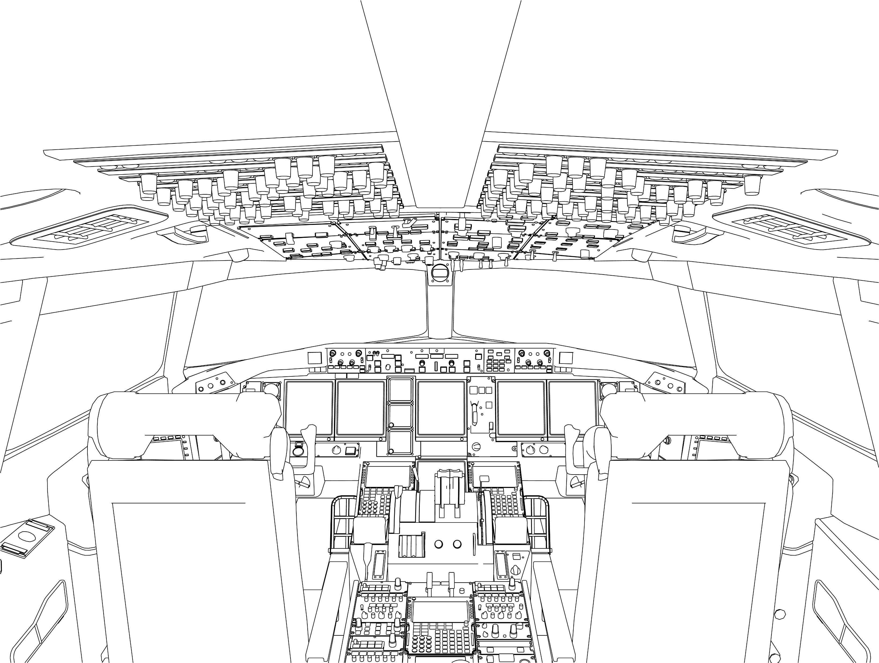
What kind of information would be necessary and sufficient for UAP analyses?
about the phenomenon
about the observer
UAP-event description or narrative
UAP location relative to the observer, with as much precision as practicable
Number of UAP-objects observed during the phenomenon and indications of intra UAP-object coordination and/or communication
Indications of advanced and/or enigmatic capabilities
UAP characteristics, including physical state (e.g., solid, liquid, gas, plasma); description (e.g., size, shape, color); signatures; propulsion means; payload
UAP performance envelope, including altitude and/or depth; travel path and trajectory; velocity; maneuverability
UAP behavior, including whether under apparent intelligent control, apparent response to observation and/or observer presence, and apparent indications of indifference or hostility
Observer’s date, time, location, and travel path for first and last observation of the UAP, with as much precision as practicable
Observer’s behavior toward the UAP
Sensors that detected the phenomenon (e.g., visual, radar)
Any physiological, psychological, or other effects apparently corresponding to the UAP observation
Observer’s assessment of the UAP, including the nature of the phenomenon and whether it was benign, a hazard, or a threat
Identification of any other observers

Slide 8
Seán Kirkpatrick, Ph.D.
Director

